Slide 1
Enterprise IT - TCO over 5 years Homework

Slide 2
Description of the environment UC & required TPS
This conceptual transaction is made of many IT transactions. Let's assume that an x86 core is able to perform 20 TPS of the these conceptual transactions
UC: Credit Card (CC) Transaction for a Bank
Every CC transaction requires:
Checking the CC is valid,
Checking the POS is valid,
Checking the money amount is valid
That the specific CC is within single transaction limits, daily limits and monthly limits
If the CC is pre-loaded CC, that there is sufficient money in the basket
Check if the transaction is suspect
Run AI to warn or stop suspect transactions
If the POS requires a second identification step, perform that step and check complete successfully,
At the end of the transaction, issue OK or abort
Store all the information about the transaction whatever is the exit status

Slide 3
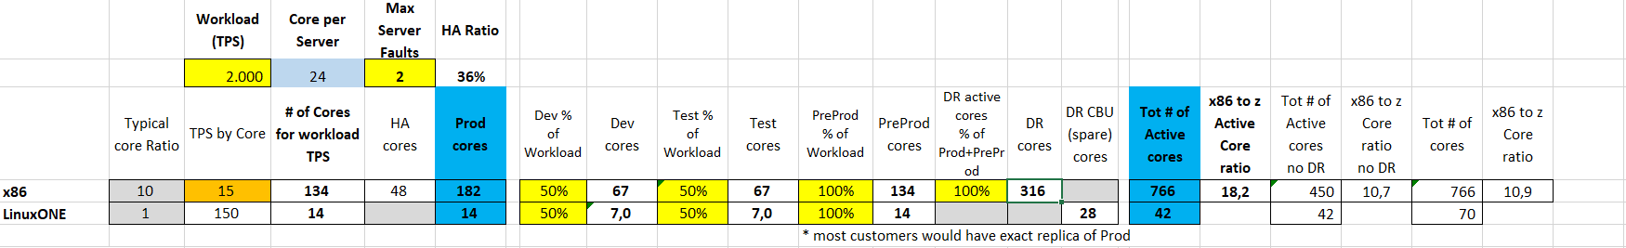
Sizing
The input provided is that the systems must support up to 2000 TPS
Our input is that a x86 core is able to process 15 TPS
Based on literature and what said previously, a LinuxONE core (aka IFL) is able to perform 10x TPS, therefore 150 TPS

Slide 4
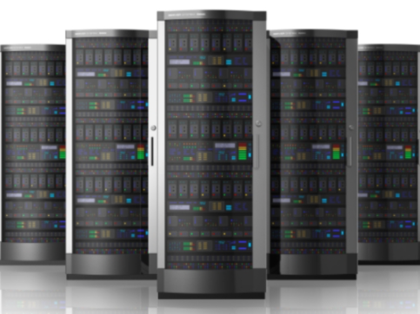
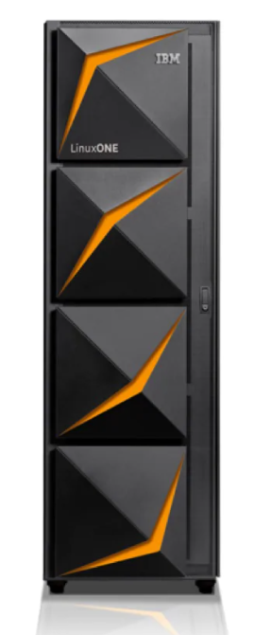
Technical Architectures for the two cases
SITE 1
SITE 2
Inputs: Workload= 2000 TPS
CASE 1:
X86 servers:
Rack server with Intel Xeon Gold 6226 2.7GH (12 cores)
34 servers
766 cores
CASE 2:
LinuxOne servers:
2 servers
42 cores (IFL)
and 28 spares (CBU)
Prod
8 servers
182 cores
Pre-Prod
6 servers
134 cores
Dev
3 server
67 cores
Test
3 servers
67 cores
DR
14 server
316 cores
SITE 1
SITE 2
1 LinuxONE with:
1 LinuxONE with:
Prod
14 cores
Dev
7 cores
Spare
14 CBU
Pre-Prod
14 cores
Dev
7 cores
Spare
14 CBU

Slide 5
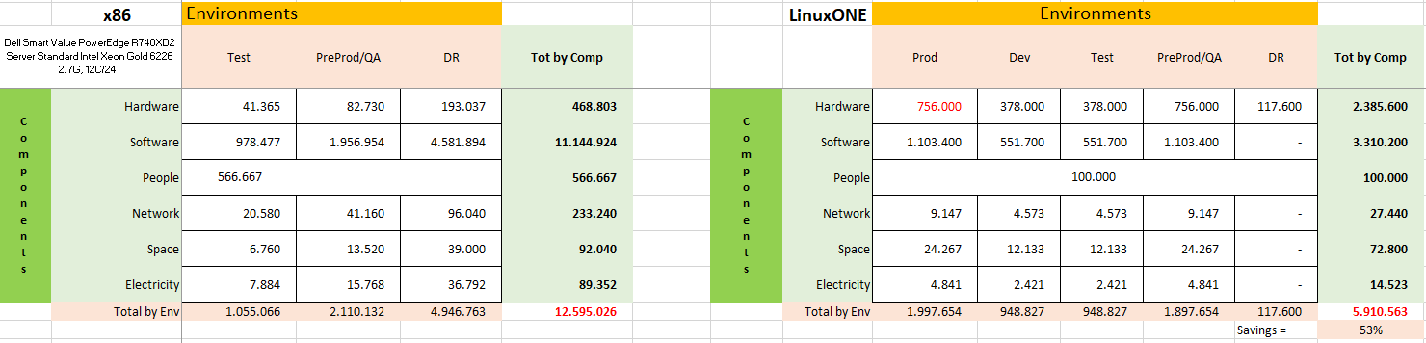
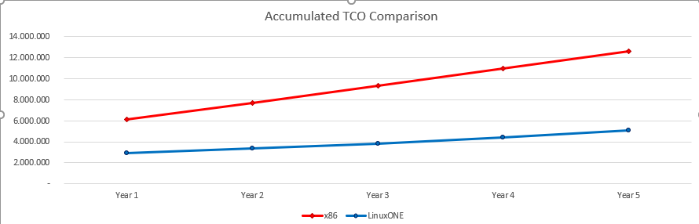
TCO Comparison on 5 years
Above schemas summarize the TCO for the different environments on 5 years, for each cost component
The savings with the LinuxONE platform is 53% vs the x86 equivalent platform
Below diagrams highlights the component contribution to total cost and cost per year that make the accumulated TCO

Slide 6
x86 TCO Assumptions
Hardware:
Dell Smart Value PowerEdge R740XD2 Server Standard Intel Xeon Gold 6226 2.7GH (12 cores)
Acquisition cost: 11.785€ - 35% discount
Support for following years is 20% of purchase price
Software:
OS: subscription 2000€/year – 20% disc per socket
VM: license 5000 €/socket -20% disc maint 20% of purchase price from y2
Application Server: license 100€/PVU -75% disc (70 PVU per core) maint 20% of purchase price from y2
DB (MySQL Cluster Carrier Grade Edition Subscriptio): license 17.964€ for socket -75% disc maint 20% of purchase price from y2
Data Replication Tools: subscription 3000€/year – 75% disc per core
Monitoring Tools: license @5.000€/server -40% disc. Maint @ 20% of PP from y2
Security Tools: license 5.000€/server -40% disc. Maint @ 20% of from y2
Network: 7000€ per Server -30% disc Maint 10% of PP from y2
People:
One FTE covers 30 servers
Average yearly fully loaded costs 100000 €
Space:
Fully loaded cost of space per sq meter 2600€
Electricity:
Electricity cost at the sites 0,10 €/Kwh

Slide 7
LinuxONE TCO Assumptions
Software:
OS: subscription 6000€/year – 20% disc per socket
VM: included in HW
Application Server: license 100€/PVU -50% disc (1200 PVU per core) maint 20% of purchase price from y2
DB (MySQL Cluster Carrier Grade Edition Subscriptio): license 17.964€ for socket -50% disc maint 20% of purchase price from y2
Data Replication Tools: subscription 3000€/year – 75% disc per core
Monitoring Tools: license 5.000€/server -40% disc. Maint 20% of PP from y2
Security Tools: license @5.000€/server -40% disc. Maint 20% of from y2
Hardware:
LinuxONE servers 1420000€ for 3 years – 30% disc
Maint 10% PP from y4
Network
14000€ per LinuxONE Server -30% disc
Maint 10% of PP from y2
People
One FTE covers 10 servers
Average yearly fully loaded costs 10000€
Space
Fully loaded cost of space per sq meter 2800€
Electricity
Cost per kWh 0,10€

Slide 8
TCO comparison
This is the graph showing the TPS on the X axis and the costs on the Y axis and has two lines representing the TCO for the x86 platform and the linuxOne platform respectively
COSTO(€) | x86 | LinuxOne
10 | 553.768 | 1.473.494
30 | 625.498 | 1.473.494
50 | 792.868 | 1.473.494
100 | 1.104.242 | 1.473.494
200 | 1.876.296 | 1.599.520
300 | 2.426.770 | 1.599.520
400 | 3.373.837 | 1.843.174
500 | 4.021.223 | 1.969.201
600 | 4.710.365 | 1.969.201
700 | 5.380.661 | 2.380.854
800 | 6.243.169 | 2.590.881
900 | 6.626.001 | 2.590.881
1000 | 7.153.109 | 3.002.535
2000 | 12.595.026 | 5.077.602
3000 | 18.033.751 | 6.942.943

Slide 9
Considerations on the convenience: x86 vs LinuxOne
From the graph we can see that for TPS =170 the LinuxOne platform and the x86 platform have similar Total Cost of Ownership (TCO).

Slide 10
LinuxOne vs x86
By analyzing the configuration in LinuxOne and x86 environment it was possible to run a model for calculating the TCO over 5 years. This model showed how the LinuxOne environment (with 2 servers and 42 cores) allows to reduce the total costs by about 60% compared to the x86 environment (34 servers and 766 cores)
Cumulative Costs | Year 1 | Year 2 | Year 3 | Year 4 | Year 5 | TOTALE
x86 | 6.093.784 | 7.719.095 | 9.344.405 | 10.969.716 | 12.595.026 | 46.722.026
LinuxONE | 2.950.909 | 3.383.182 | 3.815.455 | 4.446.529 | 5.077.602 | 19.673.677
Saving = 57,8%

Slide 11
Personal considerations
For 90% of the peak (4000 TPS) in the LinuxOne environment it is possible to use spare cores to redistribute the load. The spare cores can be activated only if necessary so they do not increase costs.
In the x86 environment it is possible to use the high reliability environment and in case of peaks use the DR cores.
For 8000 TPS it is necessary to modify the system by oversizing it so it can guarantee high reliability and disaster recovery but this requires a great increase in terms of costs which will increase by about 71%
TPS | TCO
2000 | 5.077.602
4000 | 9.219.338
8000 | 17.511.209
71% increase in costs

Slide 12
Why choose LinuxOne?
Extremely stable, requiring minimal human interaction which reduces the risk of human error.
High availability approaching 100% uptime
Extreme scalability
Supporting exponential transactional and workload growth with diminishing costs per unit of work
Cut TCO by 50% or more with savings across hardware, software, financing, personnel, power and facilities costs

